Slide 1
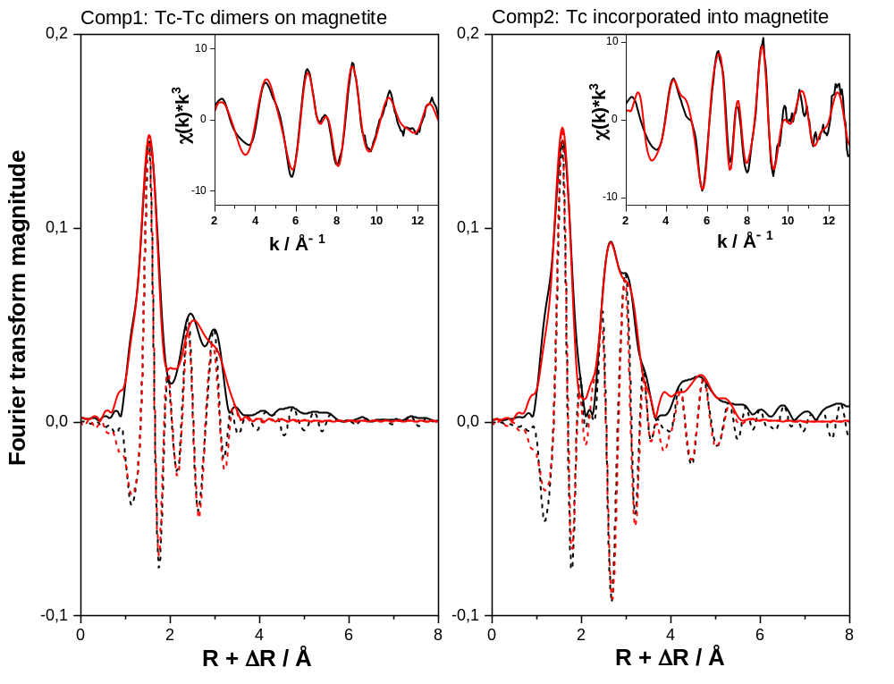

Slide 2
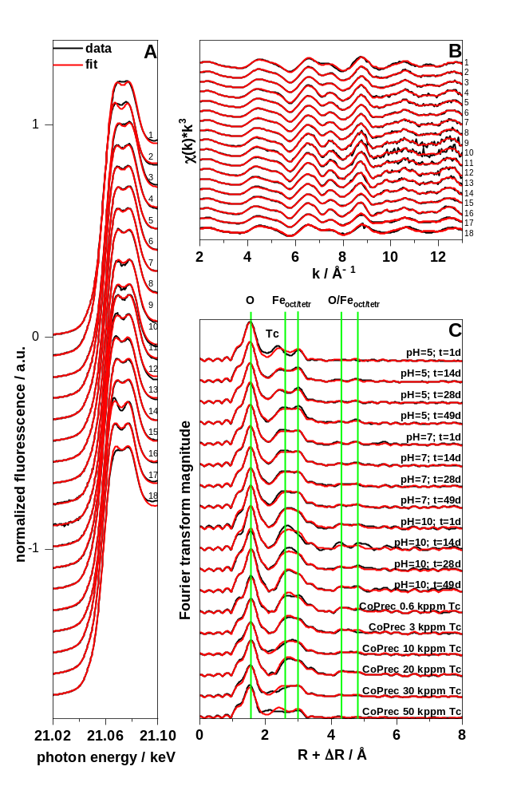

Slide 3
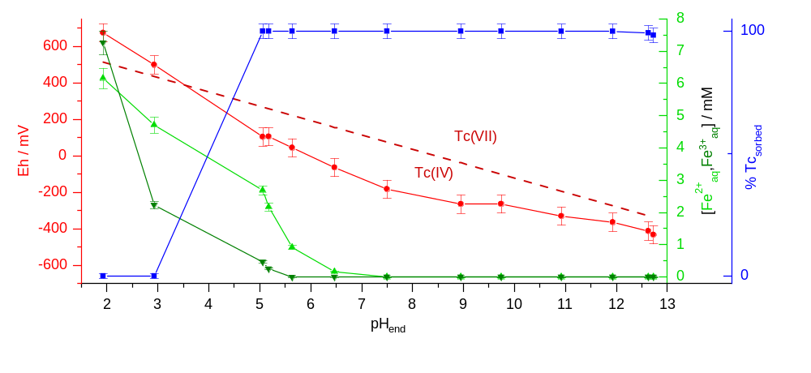

Slide 4
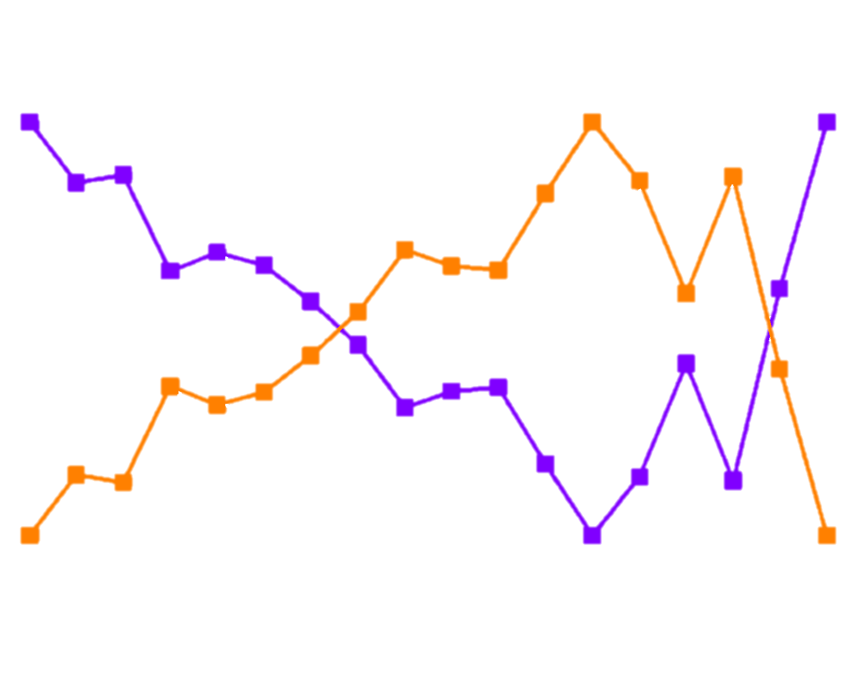
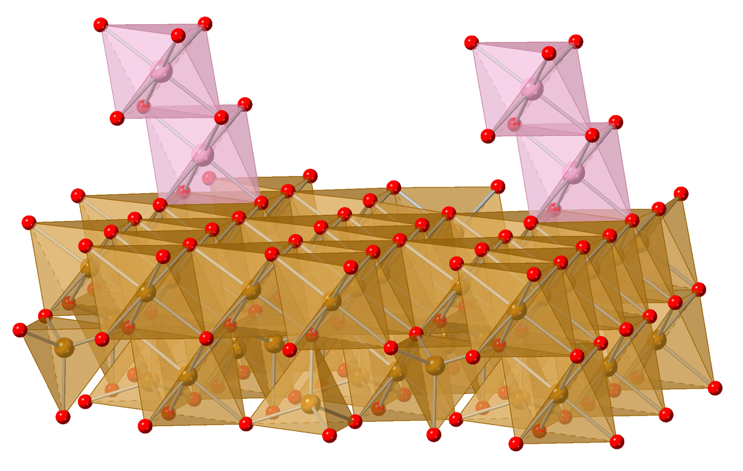
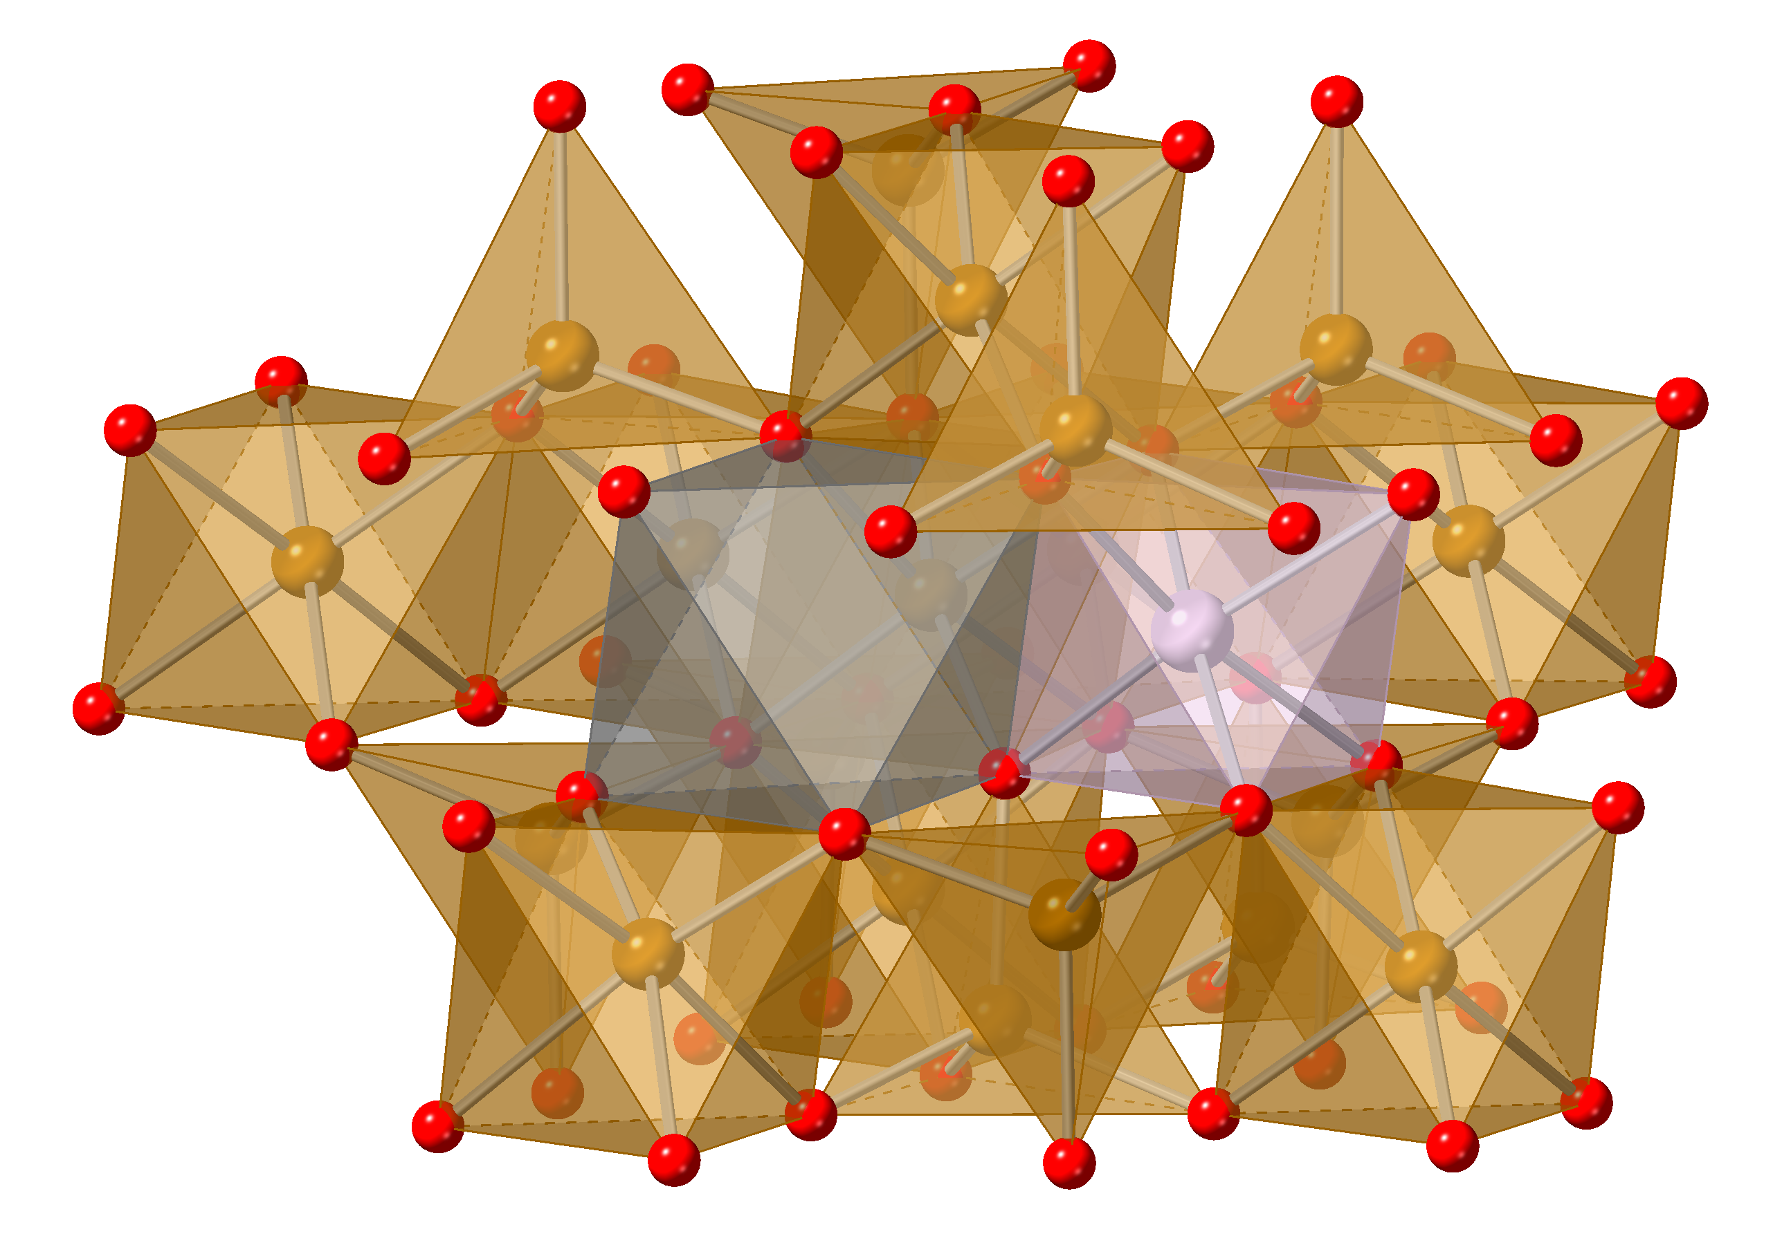
pH 5
pH 7
pH 10
CoPrec
Tc-Tc-dimers
time
time
1d
14d
28d
49d
1d
14d
28d
49d
1d
14d
28d
49d
Tc-magnetite
time
Tc
1 2 3 4 5 6

Slide 5
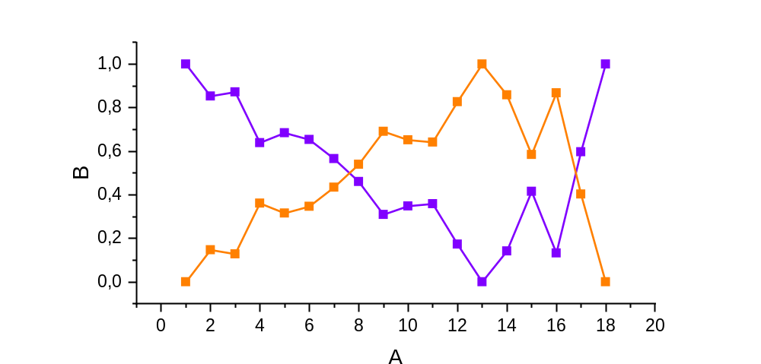

Slide 6
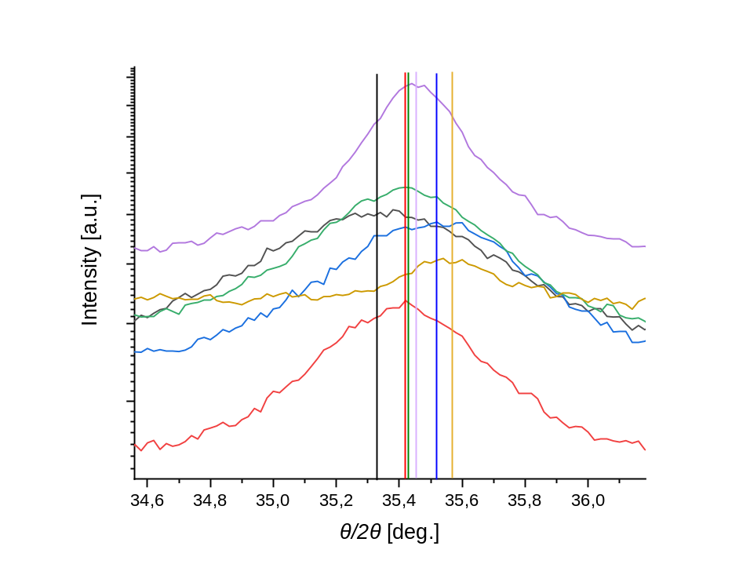
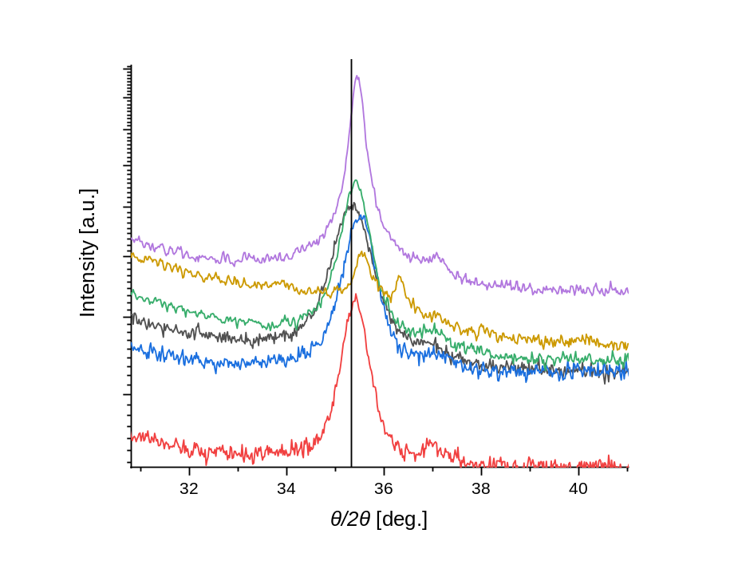

Slide 7
