Slide 1
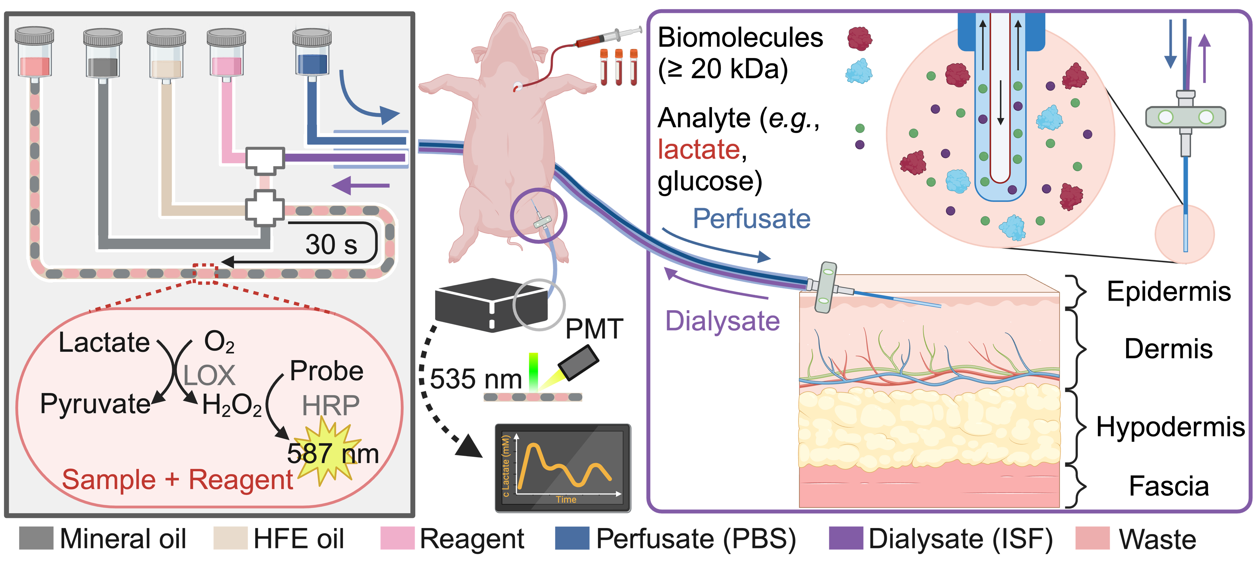
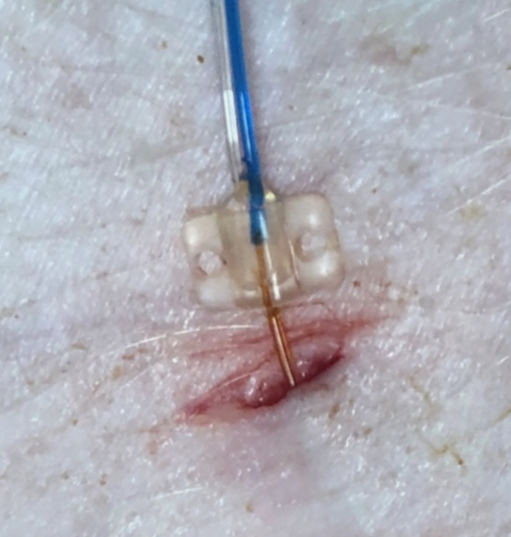
a)
b)
c)
①
②
1 cm
Notes:
Figure 1: Illustration of lactate level monitoring within a portable droplet-based microfluidic system. a) Schematic illustration of droplet generation and detection principle in the portable microfluidic device. The aqueous phase, consisting of ISF dialysate (obtained by applying a microdialysis probe and perfusate) mixed with a lactate assay reagent at a T-junction, is segmented by mineral oil spacers and carried by HFE oil as the continuous phase into a cross-junction to form a droplet sequence. Within each droplet, lactate undergoes a two-step enzymatic reaction (incubation time: 30 s), after which the resulting fluorescence signal (emission at 587 nm) is detected by a photomultiplier tube (PMT, Hamamatsu). b) Overview of ISF dialysate and blood sample collection during animal trials. The illumination source is an LED with an excitation wavelength of 535 nm, and the dynamic changes of fluorescence intensity observed in the droplet sequence corresponding to the lactate concentration are detected by a fluorescence detector, PMT. As control and reference, blood samples were intermittently collected and tested using a blood gas analyzer. c) Illustration of lactate extraction from ISF via a microdialysis probe (with a selective membrane for molecule diffusion and acquisition with size < 20 kDa) implanted in the dermis. Phosphate-buffered saline (PBS) perfusate is continuously perfused, allowing only small molecules (< 20 kDa) to diffuse into the dialysate.

Slide 2
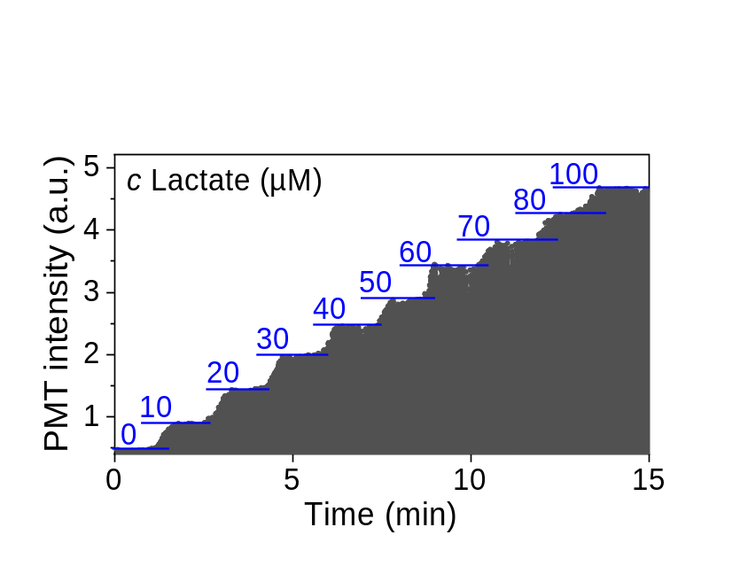
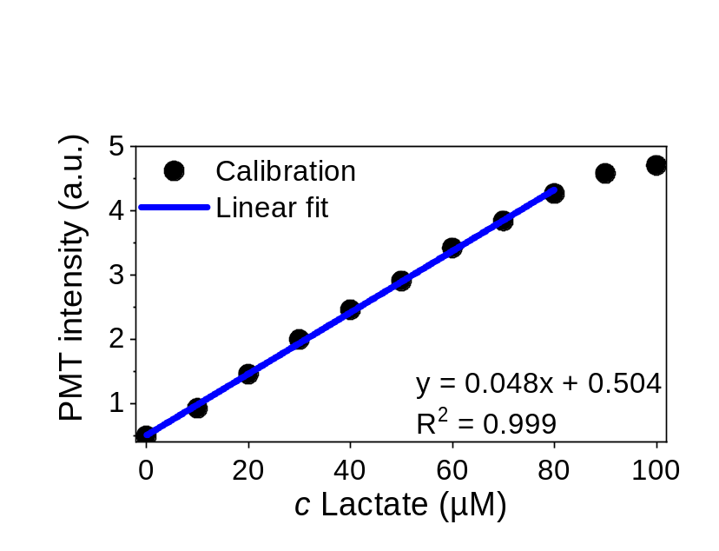
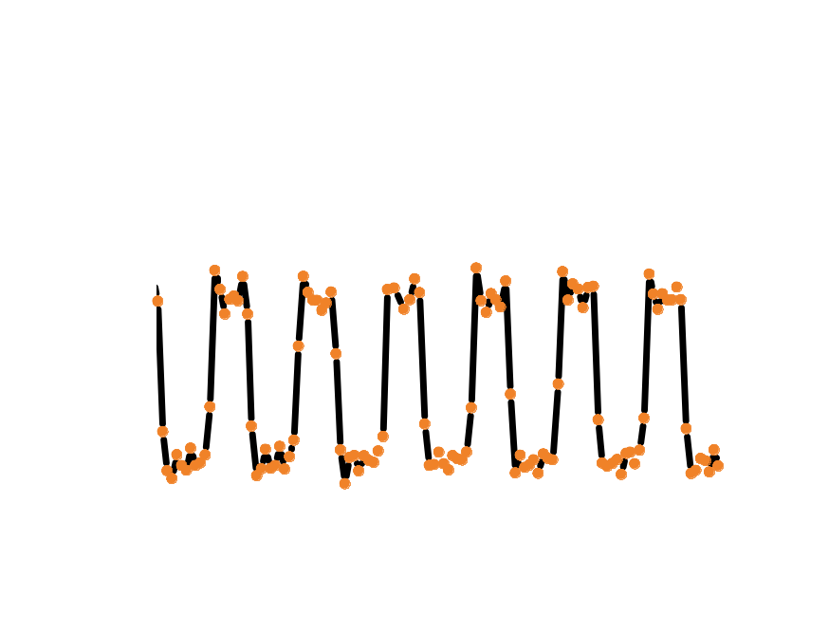
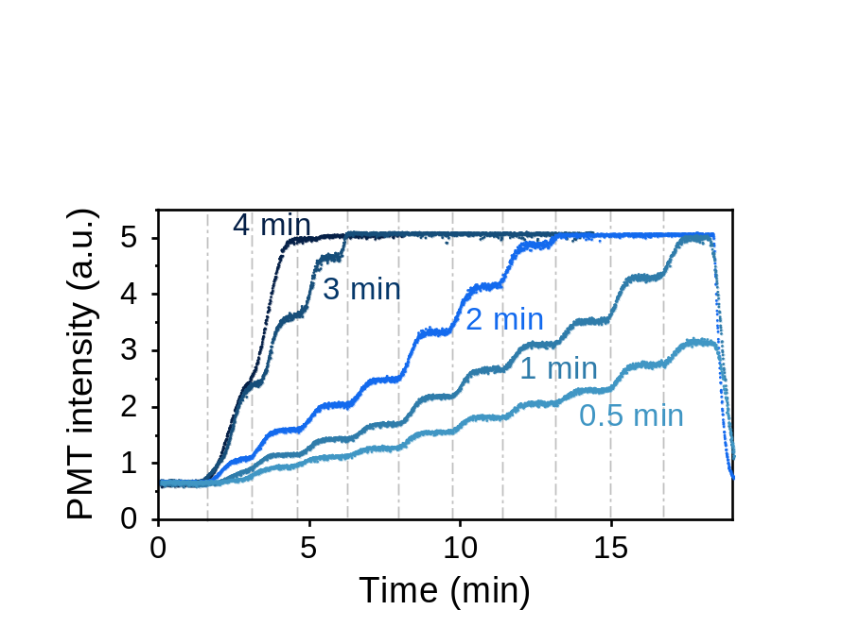
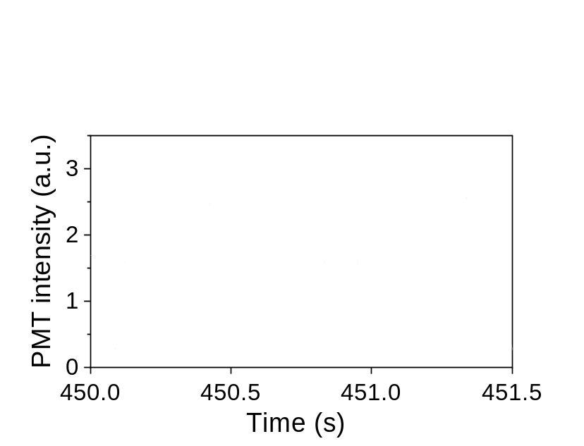

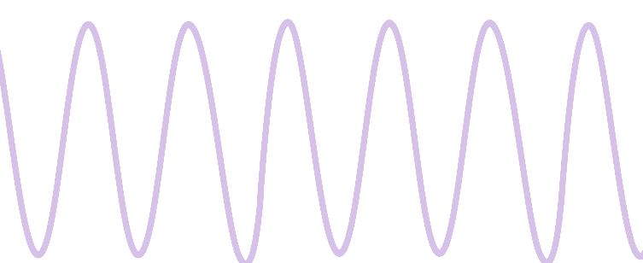
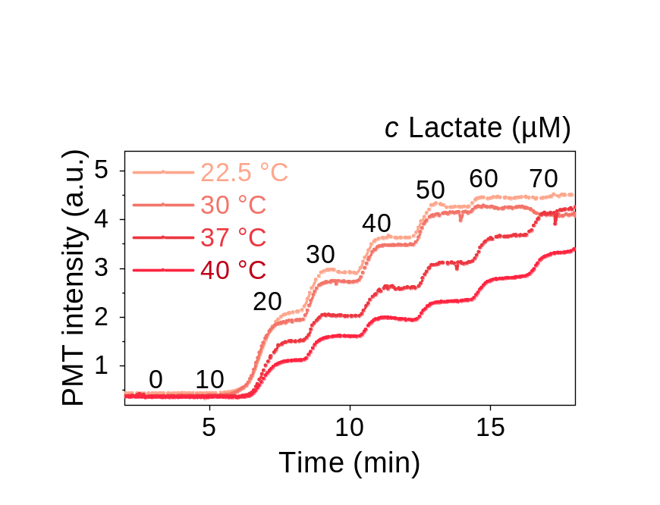
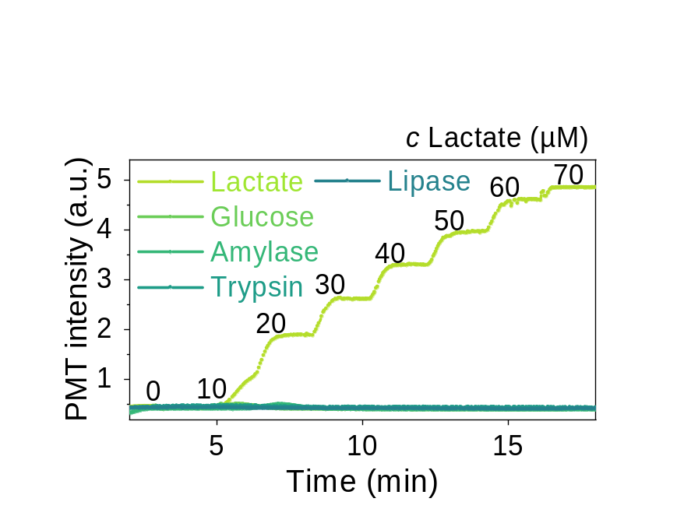
a)
b)
c)
Mineral oil
Aqueous droplet
d)
c Lactate
(µM)
0
5
10
15
20
30
40
50
60
80
100
Record data
Simulate data
e)
f)
Notes:
Figure 2: Evaluation and optimization of the droplet-based microfluidic system for lactate detection. a) Fluorescence intensity dynamics based on the reaction between the reagent and lactate solution with concentration gradients (increasing from 0 µM to 100 µM with an interval of 10 µM) in droplet-based microfluidic reactors in a PBS-DMSO solution system with a reaction time frame of 2 min. b) The calibration curve was obtained based on the fluorescence intensity and correlated lactate concentrations. c) Zoomed-in image of the area of the panel (a) that illustrates the signals of droplets (pink) and mineral oil (gray). The raw data acquisition rate for the whole droplet sequence is 70 Hz, and the signal of each droplet is obtained by selecting the maximum value from every n = 16 data points. d) Optimizing reaction time: the fluorescence intensity resulting from the reaction between lactate and a fixed reagent concentration, measured at different reaction time frames (0.5, 1, 2, 3, and 4 minutes). e) Effect of temperature on the droplet-based microfluidic system and reaction. f) Selectivity of the detection. The concentration gradients of each analyte were as follows: lactate (from 0 to 70 µM with 10 µM intervals), glucose (0 mM to 7 mM with 1 mM intervals), amylase (from 0 to 420 U/L with 60 U/L intervals), trypsin (from 0 to 0.5% with 0.05% intervals) and lipase (from 0 to 210 U/L with 30 U/L intervals). For unit µM and mM, refer to µmol/L and mmol/L, and U/L represents a unit for enzyme activity (1 U/L = 1 unit/L = 1 µmol min⁻¹ L⁻¹).

Slide 3
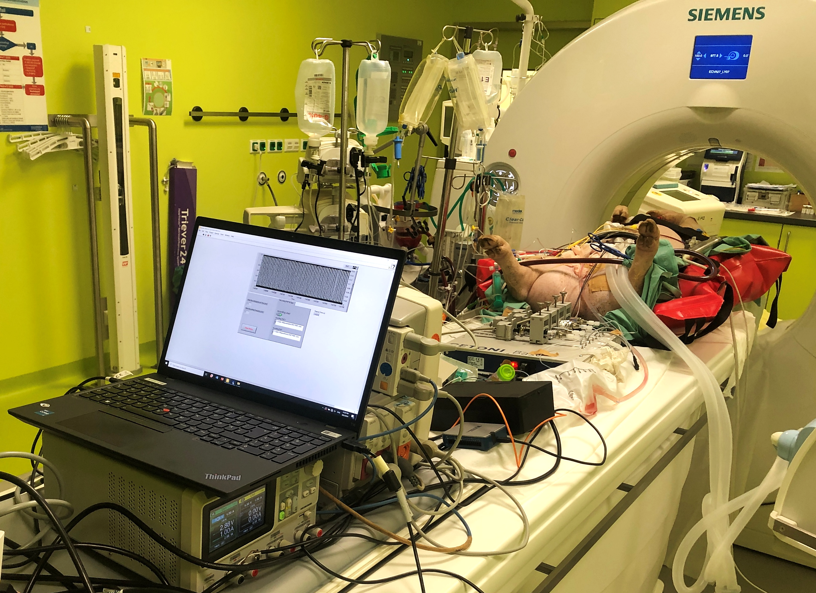
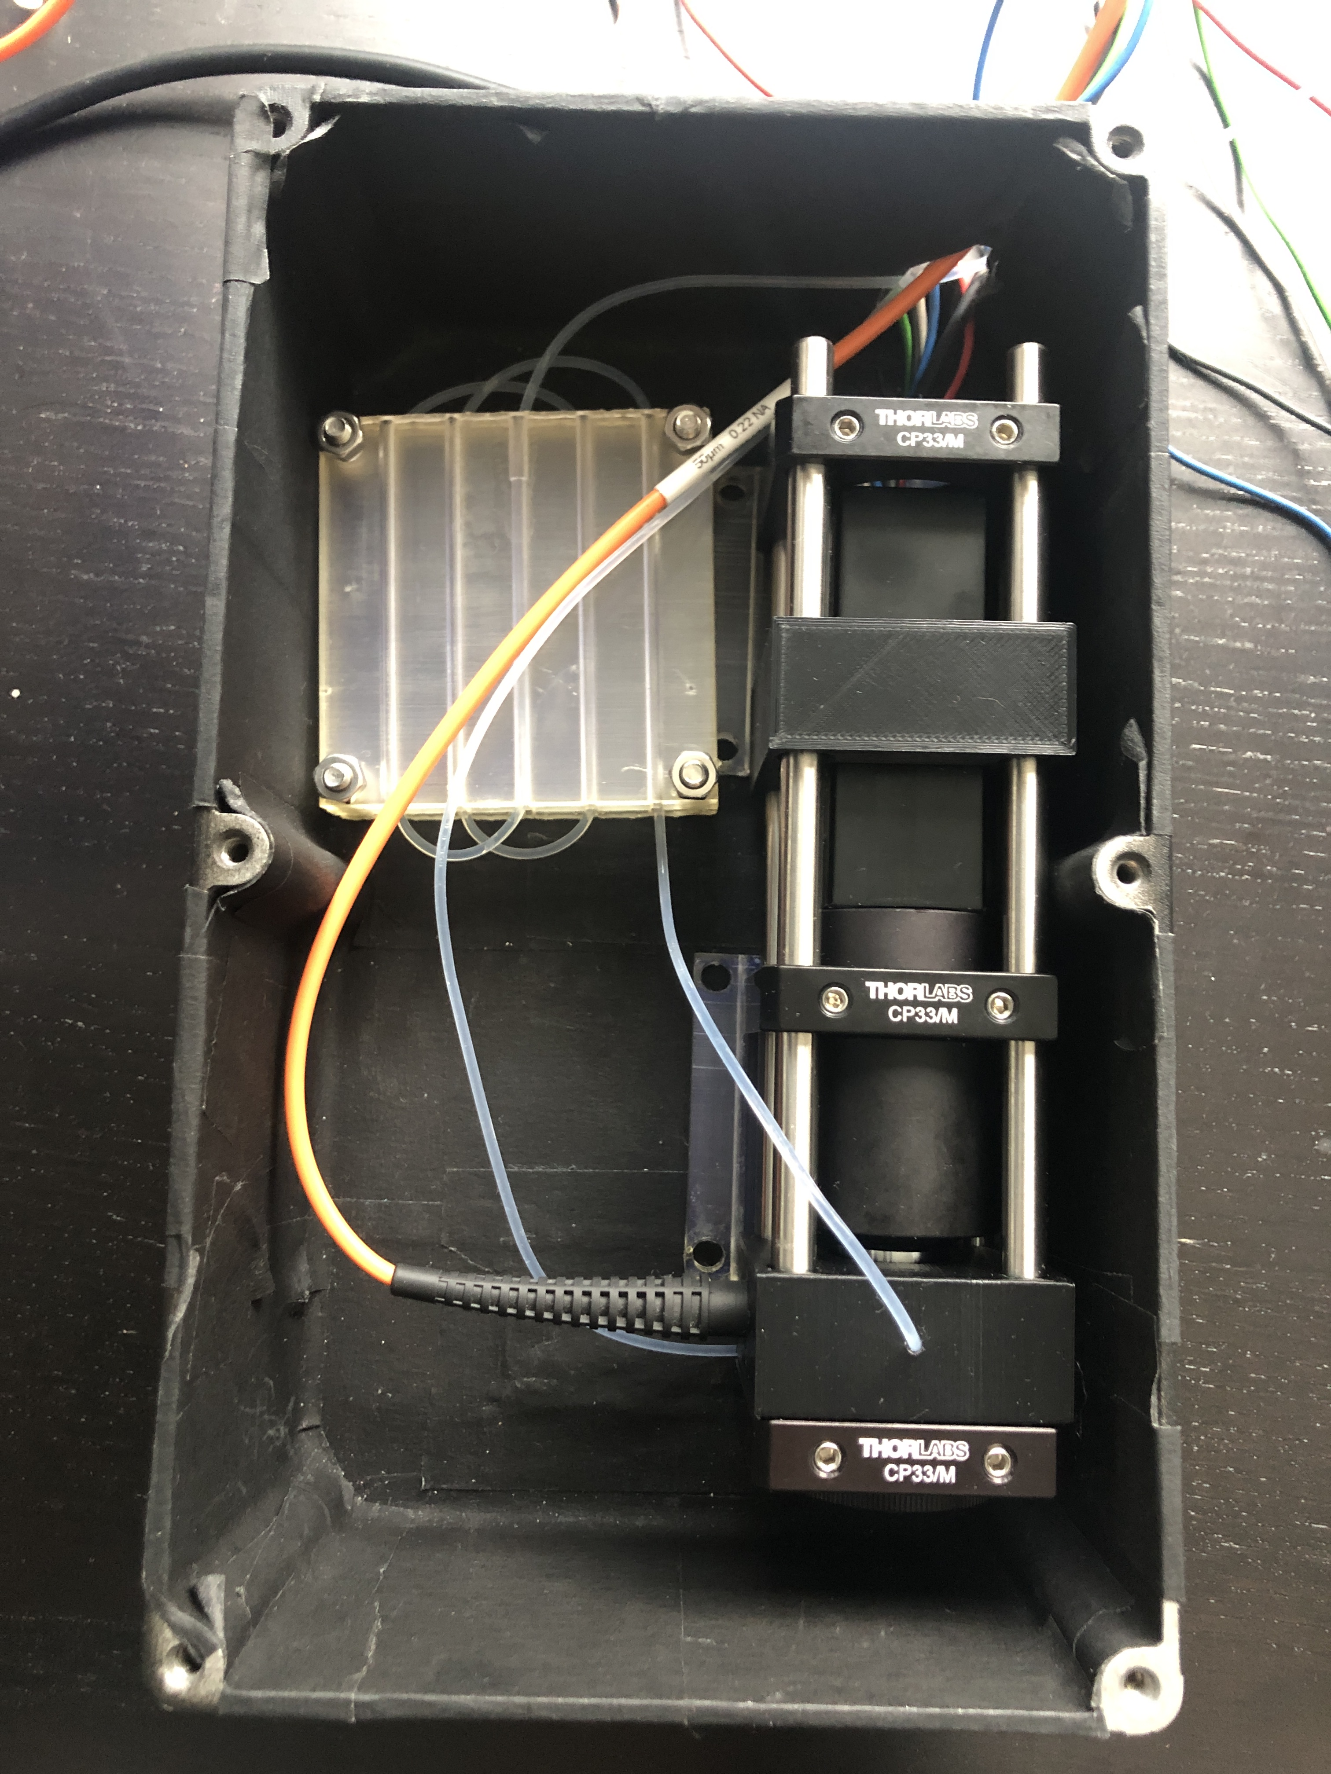
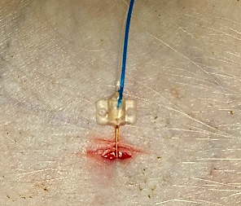
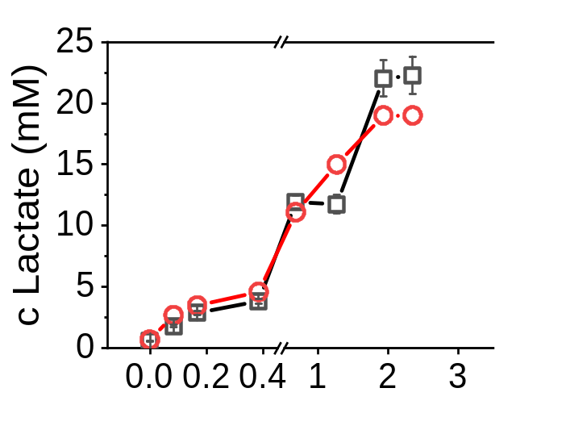
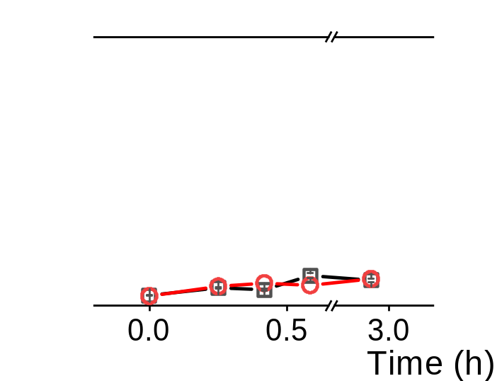
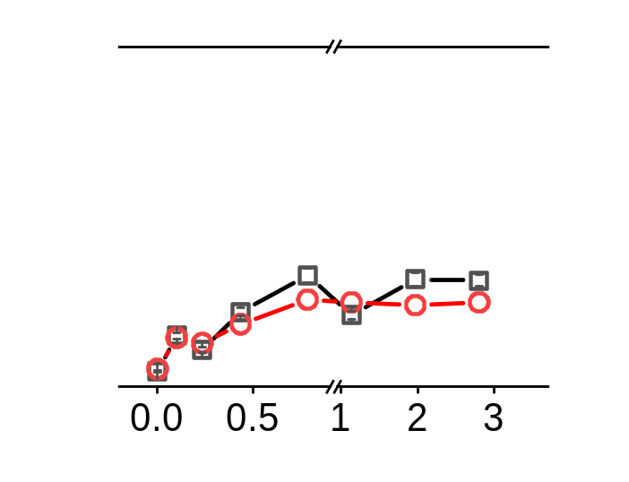
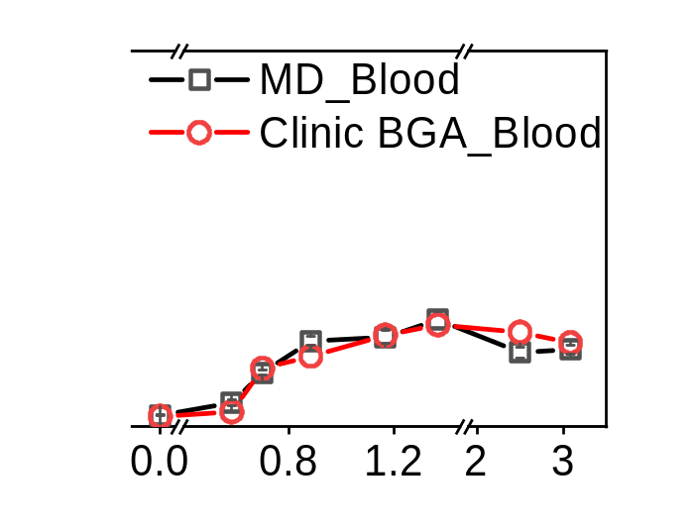
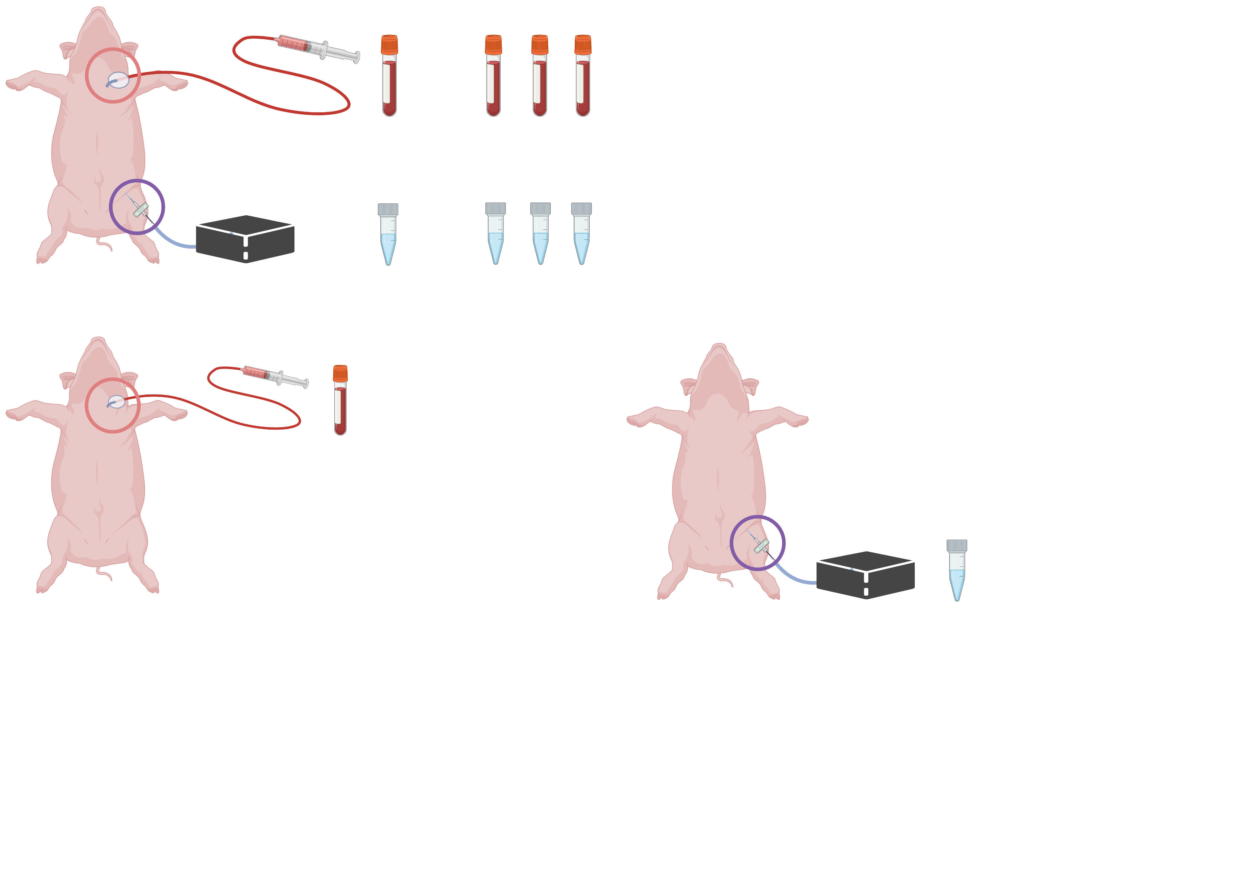
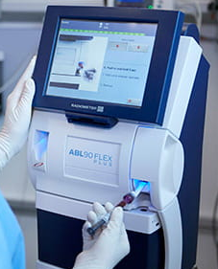
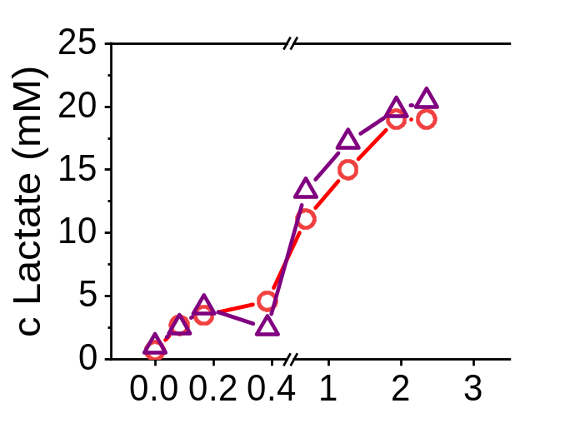
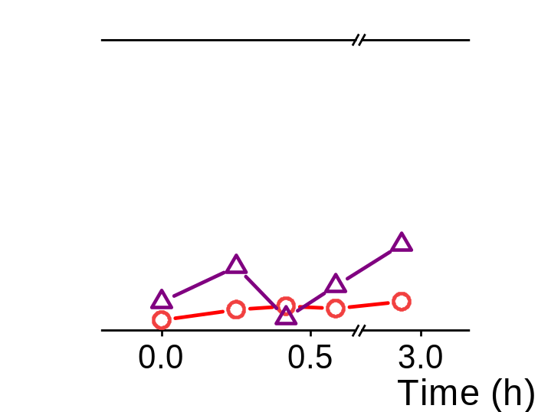
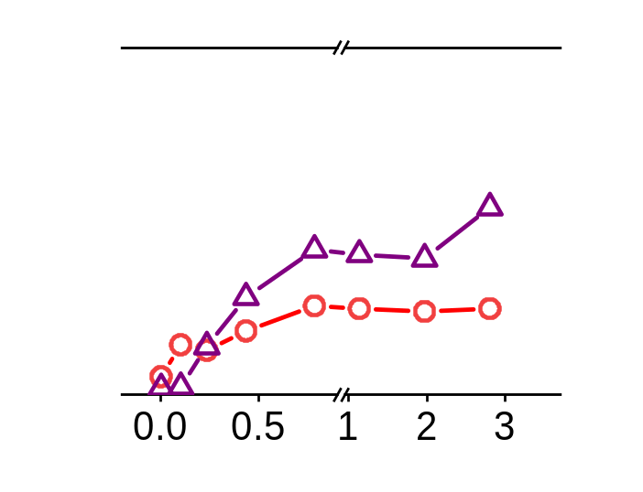
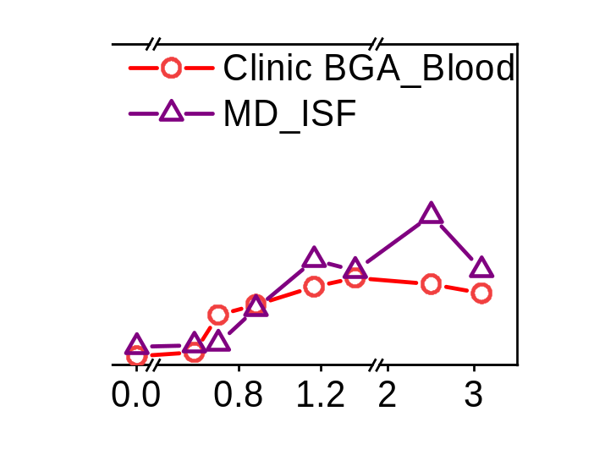

a)
b)
c)
i
ii
Probe
Pumps
iii
v
iv
Portable device
1 cm
Laptop
d)
e)
Notes:
Figure 3: Comparison of lactate levels in blood and ISF measured via droplet-based microfluidics (MD) and a blood gas analyzer (BGA) during animal trials. a) Photographs of simultaneous monitoring of lactate in animal trials using a pig model in the CT room. The portable droplet-based microfluidics device was positioned at the bedside (blue frame) and connected to the animal tissue with a microdialysis probe (red frame). b) Components of the portable device used for lactate monitoring in droplet form: i. Optical fiber; ii. Tubing holder, iii. Optical detector holder; iv. Objective lens (20×); v. PMT. c) Microdialysis probe inserted into the dermis of pig skin for ISF lactate dialysate collection. Scale bars, 1 cm. d) Blood sample collection and detection. Comparison of blood lactate detection results between the blood gas analyzer (reference results) and droplet-based microfluidics methods in 29 blood samples (in 4 animal trials). e) Acquisition and detection of ISF dialysate with a microdialysis probe during animal trials. The working principle of the microdialysis probe is to use a pump to infuse PBS perfusate into the microdialysis probe to exchange the lactate molecules from the ISF to the dialysate. A microdialysis probe was inserted under the pig skin and affixed with medical tape (for 3–4 hours). Comparison of lactate levels in 29 ISF dialysate samples (from 4 trials) measured by droplet-based microfluidics with corresponding blood lactate levels. ISF lactate concentrations were corrected for the microdialysis probe recovery (~10%) in the intermittent sampling mode.

Slide 4
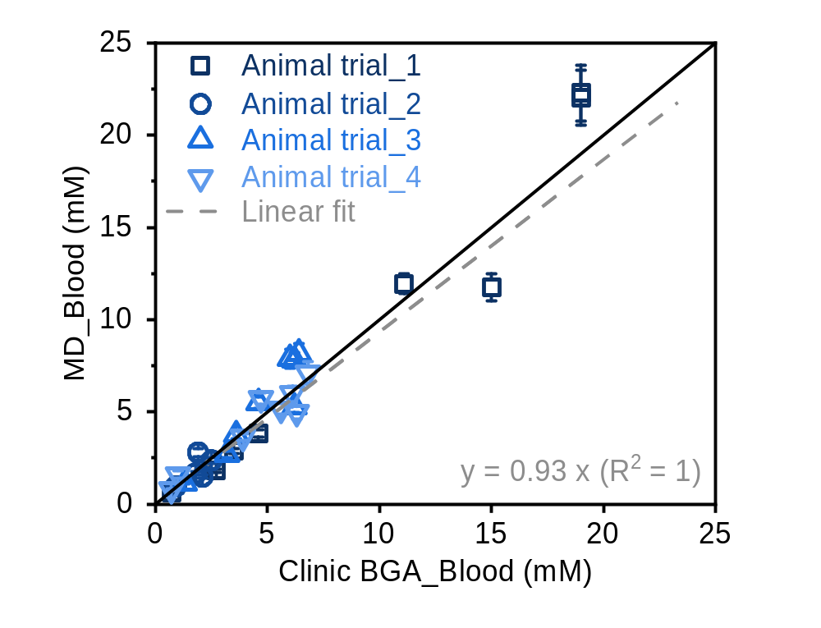
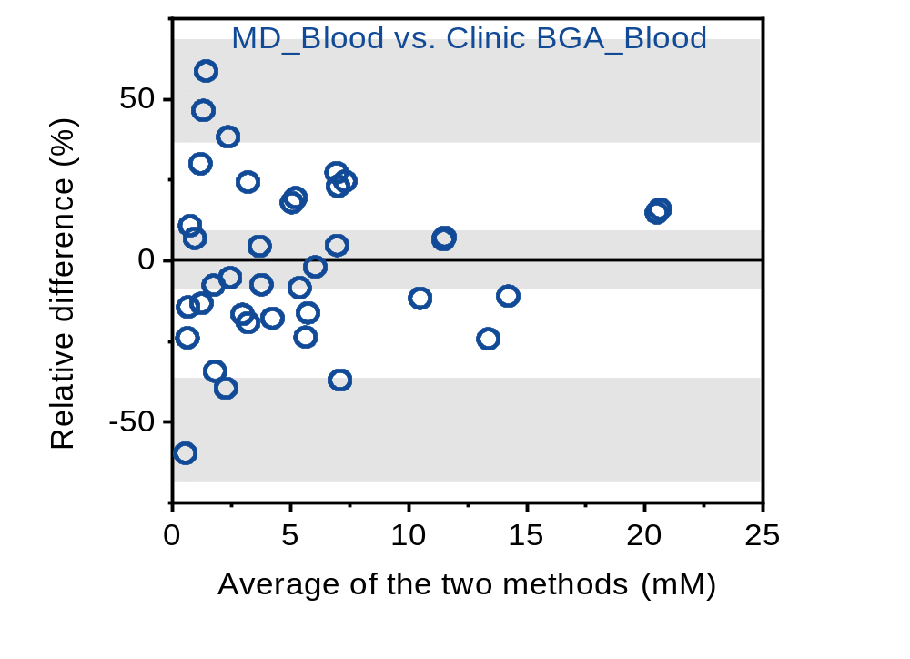
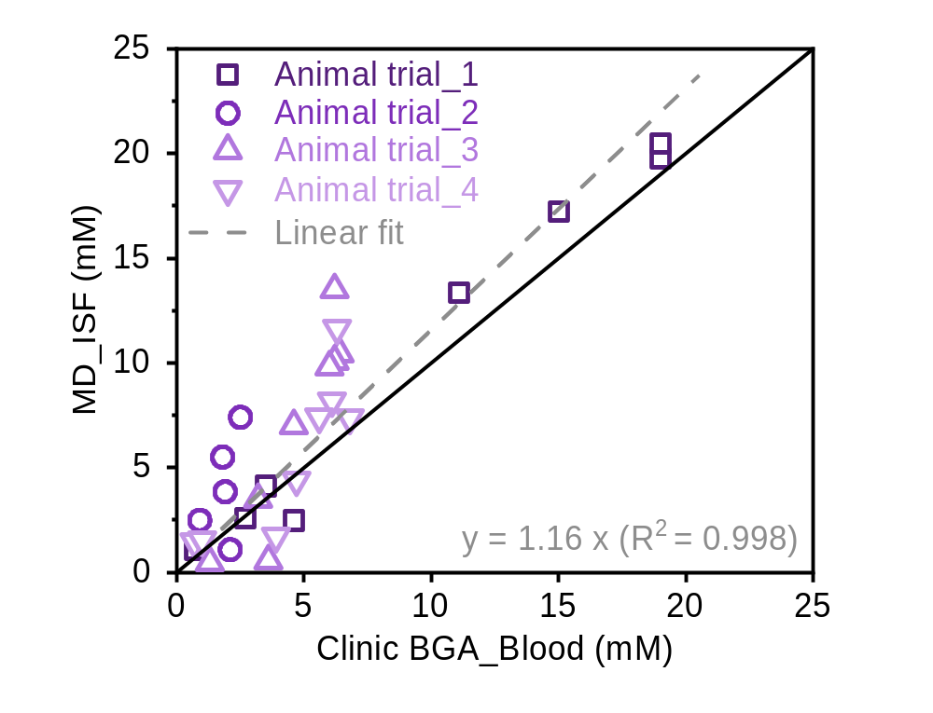
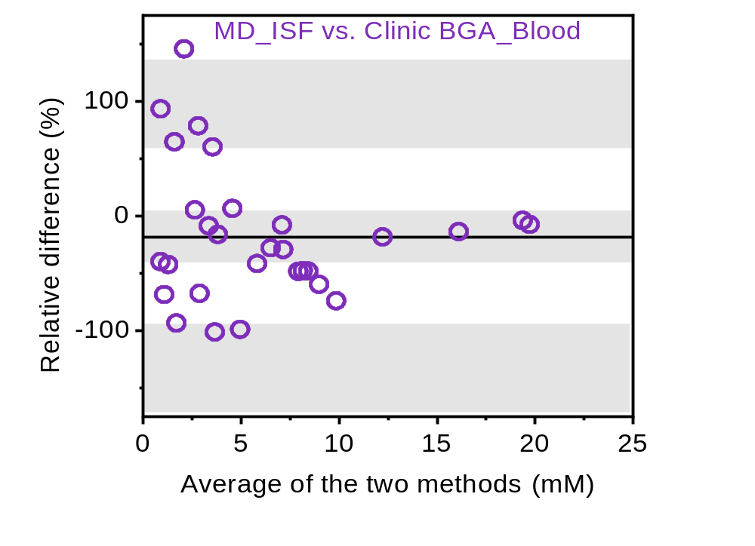
a)
b)
c)
d)
Notes:
Figure 4: Correlations and agreement of the lactate detection results for the blood and ISF samples (n=29) between the blood gas analyzer and droplet-based microfluidics. a) Correlation of lactate detection in blood samples between the clinical (blood gas analyzer, Clinic BGA_Blood) and microfluidic (MD_Blood) methods. The solid black line represents y = x. The gray dashed line represents the linear fit of the results. The error bars represent the standard deviation calculated over 100 droplets. b) Bland‒Altman agreement plot of blood detection results from the clinical and microfluidic methods. The x-axis displays the mean value measured by the two methods; the y-axis represents the ratio of the difference between the measured values of the two methods and the mean value. The black line represents the mean of the difference (d̅, black dashed lines). The limits of agreement with 95% confidence are from -1.96σ to +1.96σ (σ, standard deviation) with confidence intervals marked as gray areas. c) Correlation of lactate detection results between blood samples measured with the blood gas analyzer (Clinic BGA_Blood) and ISF samples measured with microfluidic methods (MD_ISF). d) Bland‒Altman agreement plot of detection results from the clinical (blood sample) and microfluidic (ISF samples) methods. ISF lactate concentrations were corrected for the microdialysis probe recovery (~10%).

Slide 5

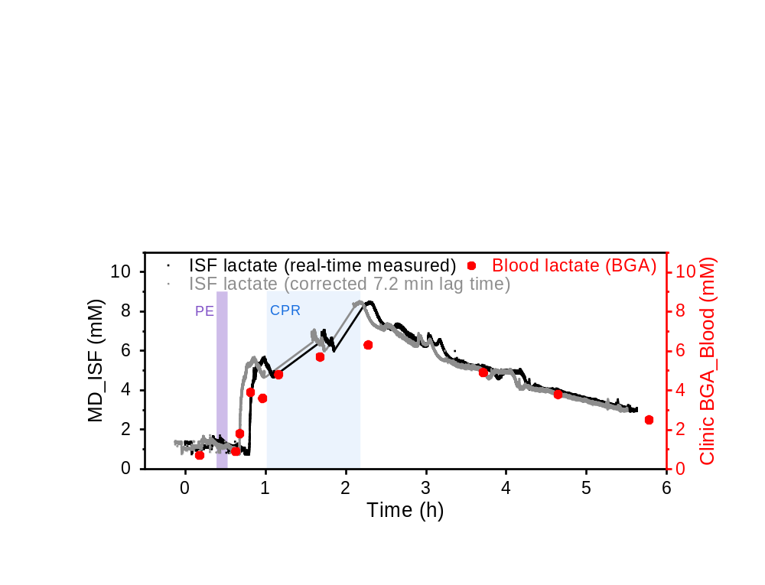
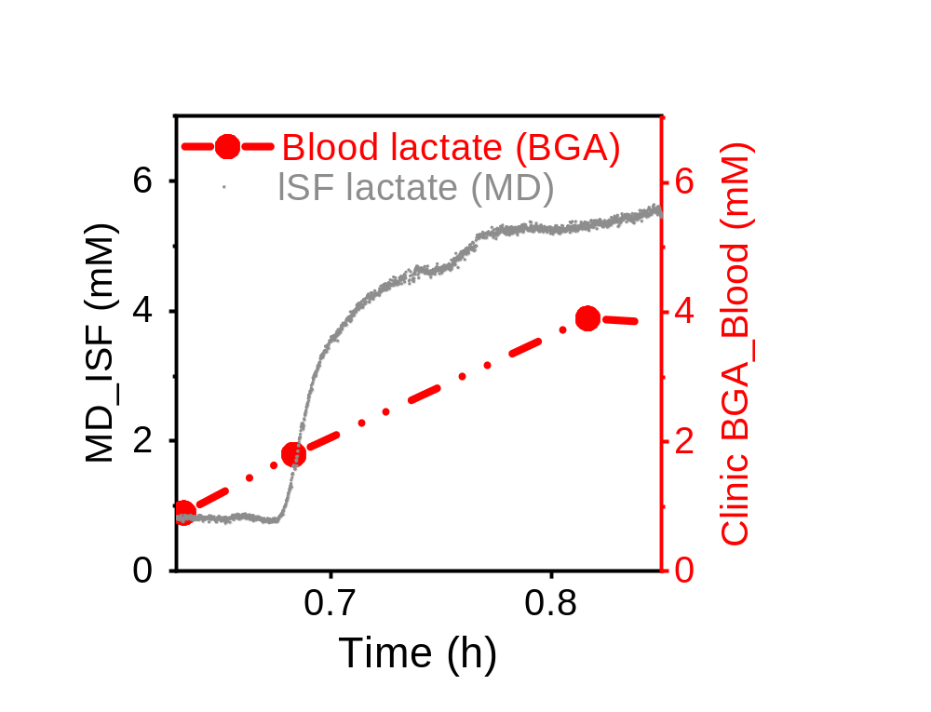
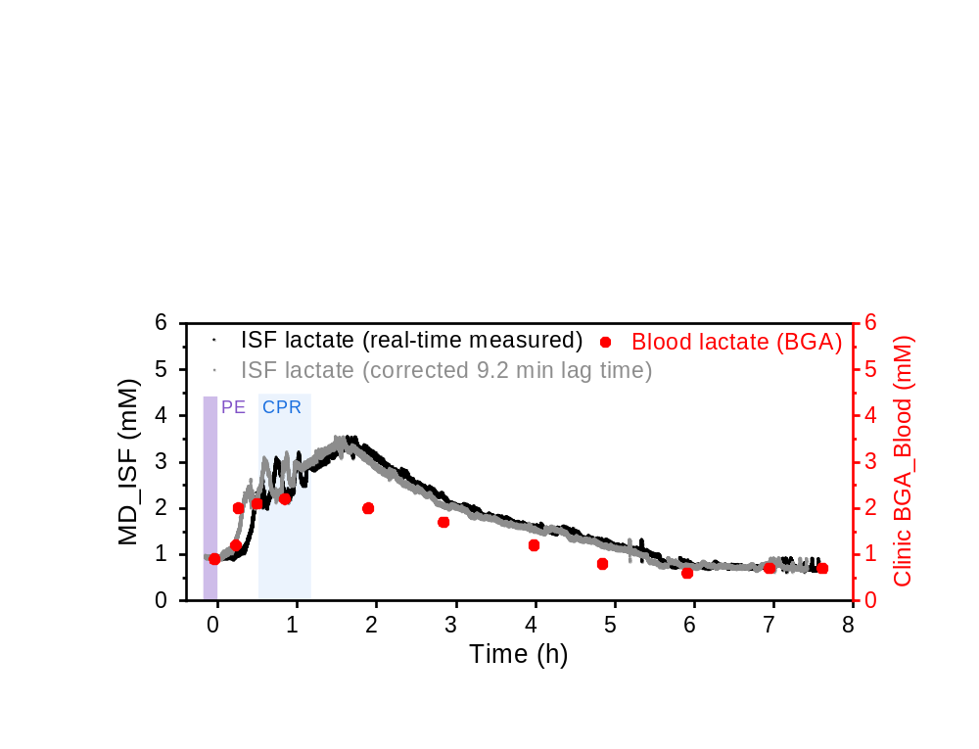
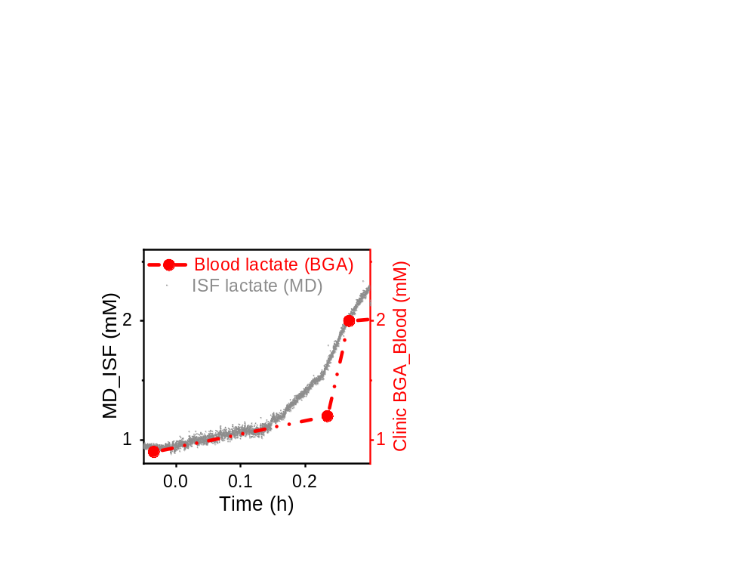
a)
Lactate rapid increase
Lactate slow decrease
Anestesia
PE induction
CPR and medical treatment
End of trial
Blood samples (measure lactate concentrations)
b)
c)
d)
e)
Notes:
Figure 5: Continuous monitoring of ISF lactate in animal trials. a) Lactate concentration measurements during pulmonary embolism (PE) induction in pigs, a well-established model that subsequently causes an increase in lactate concentration. Blood samples were collected and analyzed at 5–10-minute intervals during cardiopulmonary resuscitation (CPR), with extended intervals of 30–60 minutes post-resuscitation, once the heart rate returned to normal. Representative real-time and corrected ISF lactate (droplet-based microfluidics) and blood lactate (blood gas analyzer, BGA) data from 2 animal trials. b) and d) Monitoring of real-time ISF lactate (black dots), corrected ISF lactate (gray dots), and blood lactate (red dots) in a pig model before and after PE induction and CPR. c) and e) Comparison of sampling rates between droplet-based microfluidics (MD_ISF) and a blood gas analyzer (Clinic BGA_Blood) during the period of rapid lactate increase (highlighted in pink). ISF lactate concentrations were corrected for the microdialysis probe recovery (~1.1%) in the continuous monitoring mode.

Slide 6
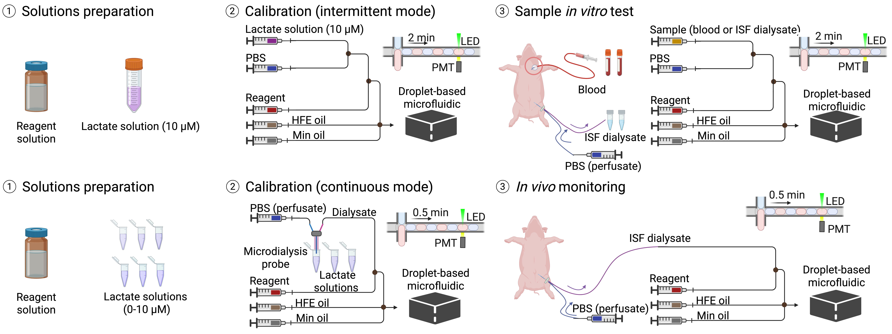
a) Flow diagram for intermittent detection mode
b) Flow diagram for continuous monitoring mode
Notes:
Figure S1: Flow diagram of calibration and sample detection in a) intermittent mode and b) continuous mode.

Slide 7
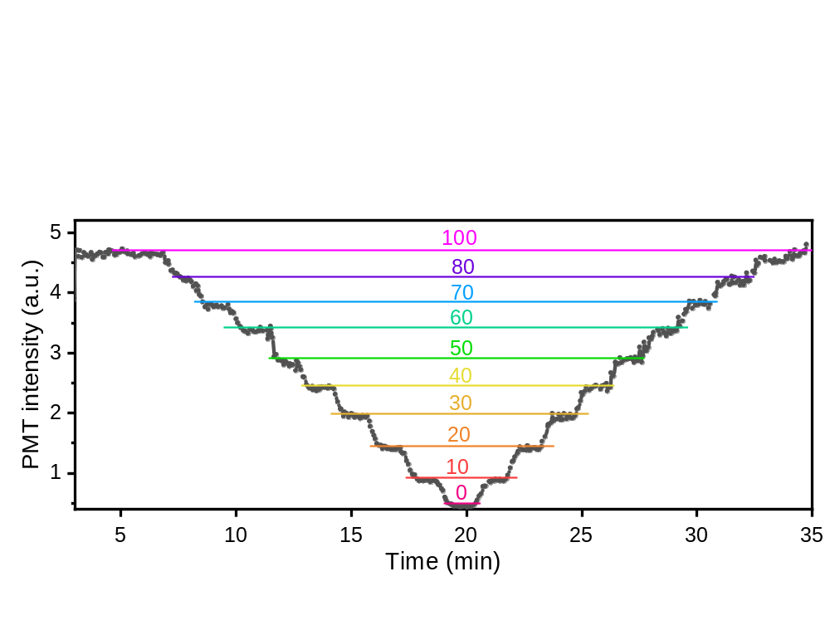
c Lactate (μM)
Notes:
Figure S2: Dynamic fluorescence intensity response to varying lactate concentrations in a PBS-DMSO solution measured in the droplet-based microfluidic. Lactate levels were decreased from 100 µM to 0 µM and then increased back to 100 µM in 10 µM intervals. The measurement was conducted in a continuous flow with a 2-minute reaction time.

Slide 8
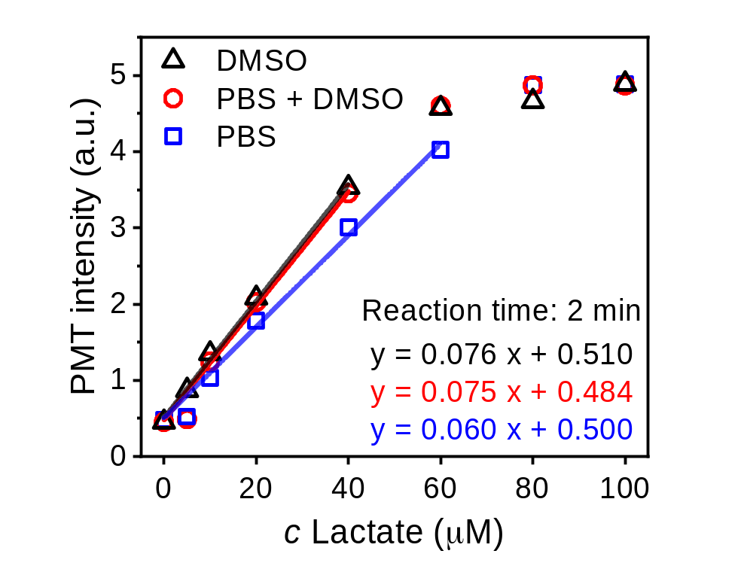
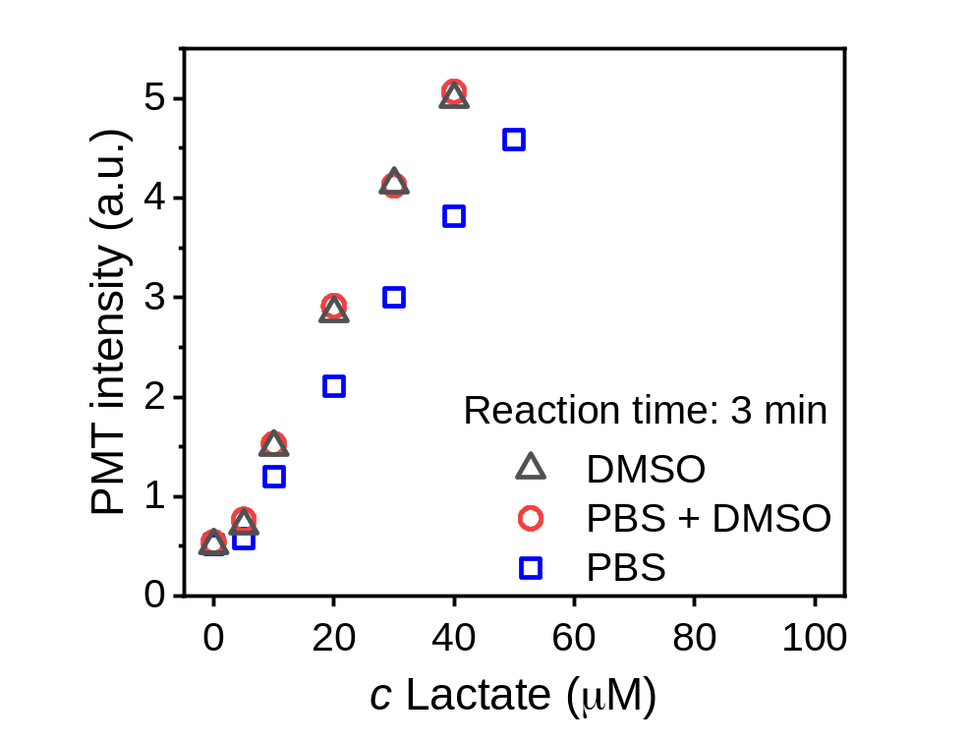
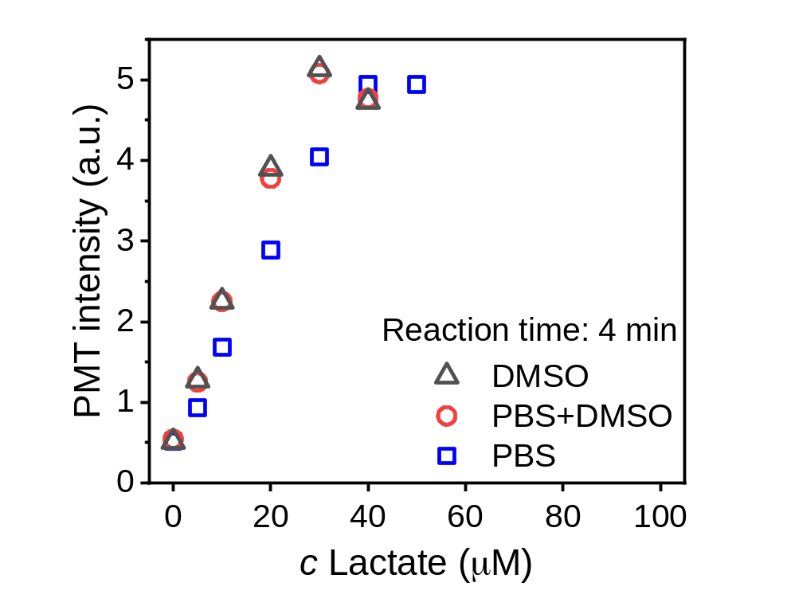
a)
b)
c)
Notes:
Figure S3: Evaluation and optimization of the buffer composition for lactate detection in the droplet-based
microfluidic system. The effect of buffer solutions on reaction kinetics was assessed at three different reaction time frames: a) 2 min, b) 3 min, and c) 4 min.

Slide 9
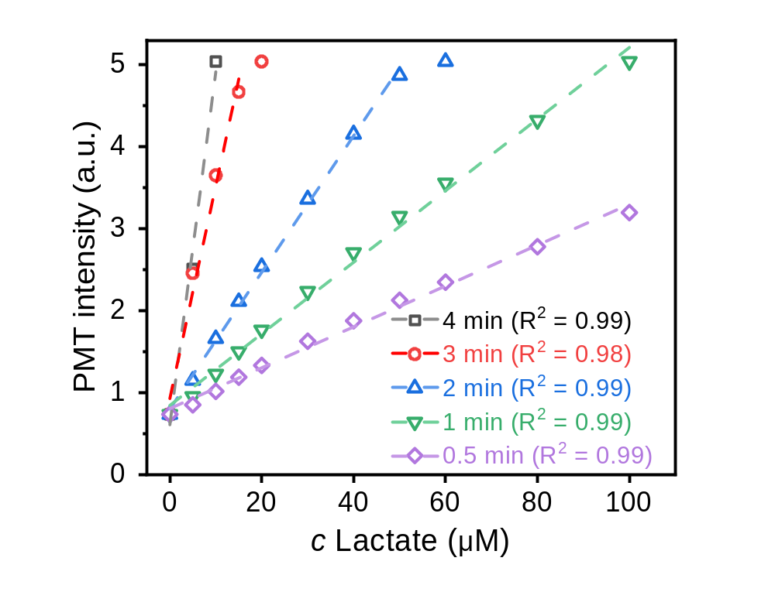
Notes:
Figure S4: Calibration and comparison of the fluorescence intensity resulting from the reaction between lactate and a fixed reagent concentration, measured at different reaction time frames: 0.5, 1, 2, 3, and 4 minutes.

Slide 10
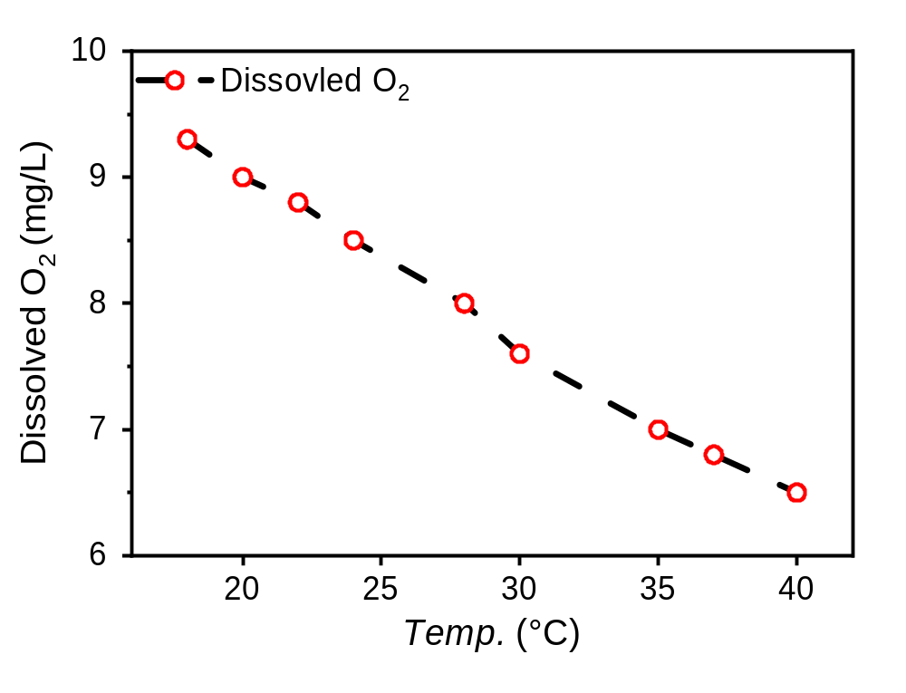
Notes:
Figure S5. Oxygen solubility (dissolved O₂ concentration, mg/L) in water at different temperatures (°C).

Slide 11
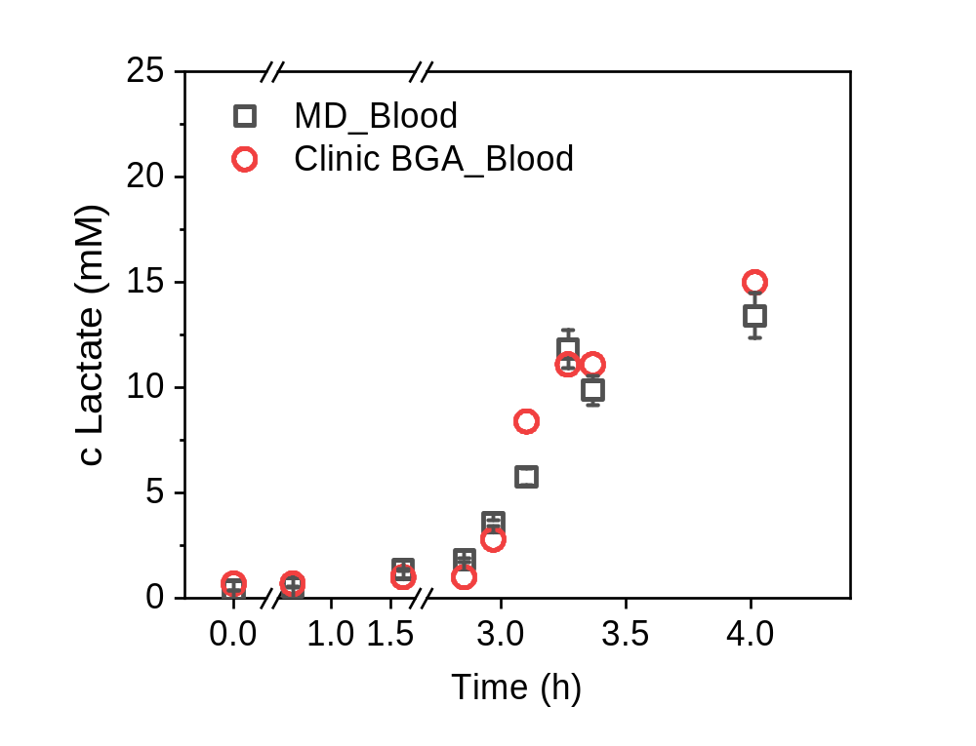
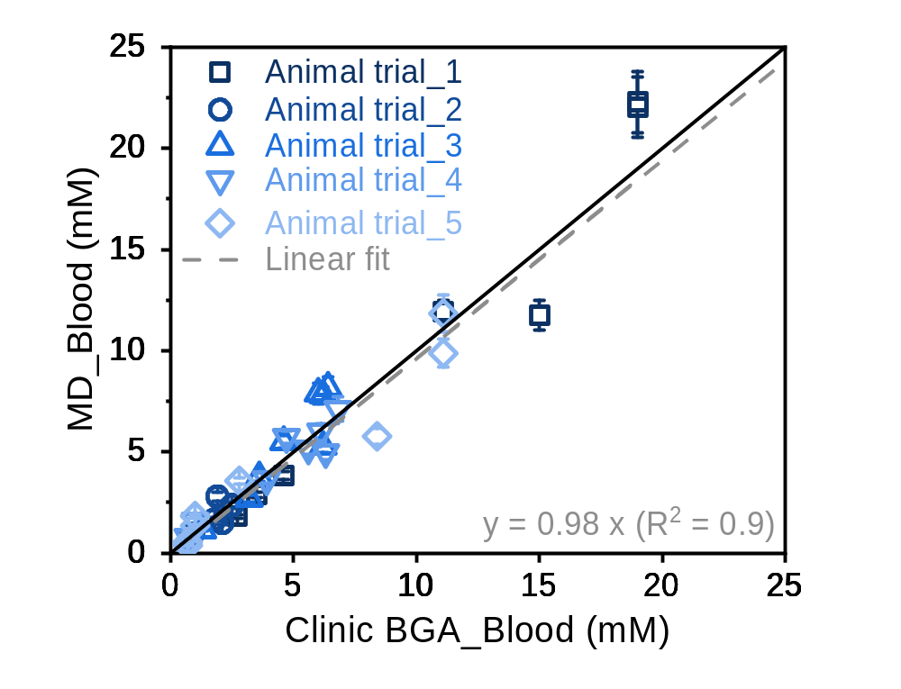
a)
b)
Notes:
Figure S6: Blood sample collection and lactate detection in Animal trial_5 (in vitro). a) Comparison of lactate concentrations in 9 blood samples (from Animal trial_5), measured using the clinical blood gas analyzer (Clinic BGA_Blood, reference) and the droplet-based microfluidic system (MD_Blood). b) Correlation of lactate detection between two methods across 5 animal trials. The solid black line represents the line of identity y = x. Error bars represent the standard deviation from measurements across 100 droplets per sample.

Slide 12
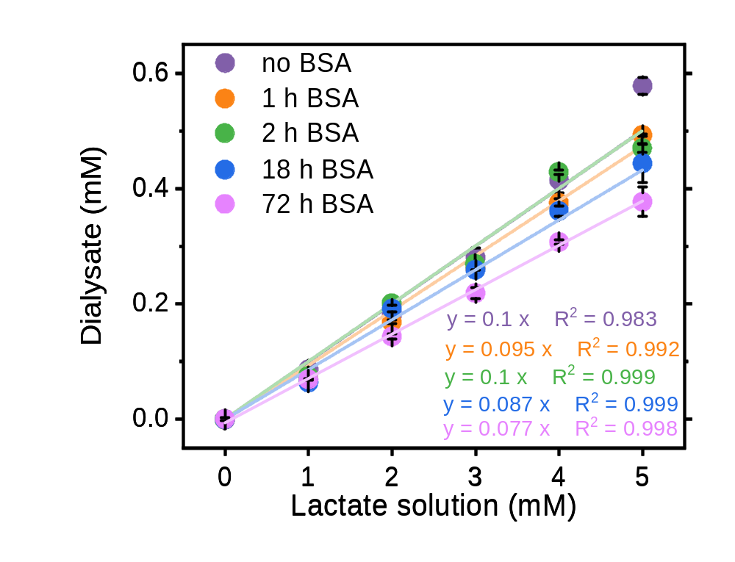
Notes:
Figure S7: Evaluation of the microdialysis probe recovery in artificial ISF solution (intermittent mode) and its stability during the long-term monitoring period.

Slide 13
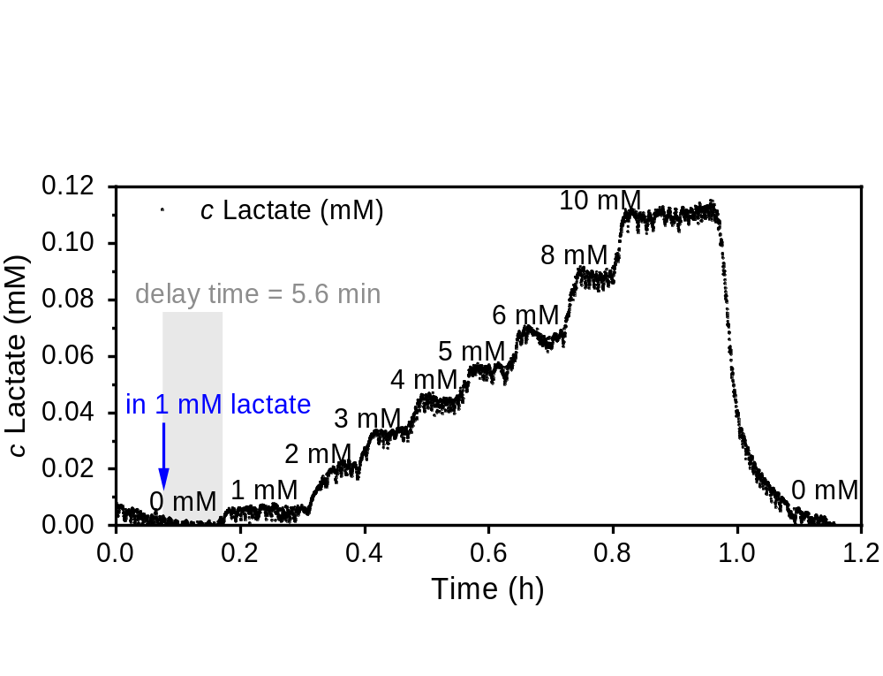
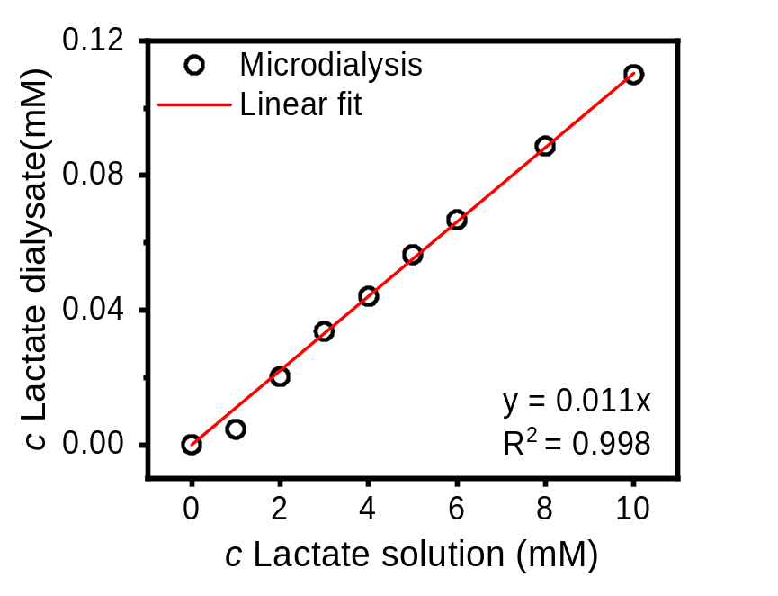
a)
b)
Notes:
Figure S8: Simulation of continuous lactate monitoring to evaluate microdialysis probe recovery and system response delay in continuous mode. a) Simulating lactate dynamic change in ISF by placing a microdialysis probe in series lactate solutions (dissolved in 1 mL PBS) with concentrations ranging from 0 mM to 10 mM, over time intervals of 5–10 minutes. A time delay of 5.6 minutes was observed between probe placement in 1 mM lactate and the corresponding increase in dialysate concentration. b) Comparison between standard lactate solution concentrations and measured dialysate values. The recovery of the microdialysis probe is calculated to be 1.100 ± 0.015%.

Slide 14
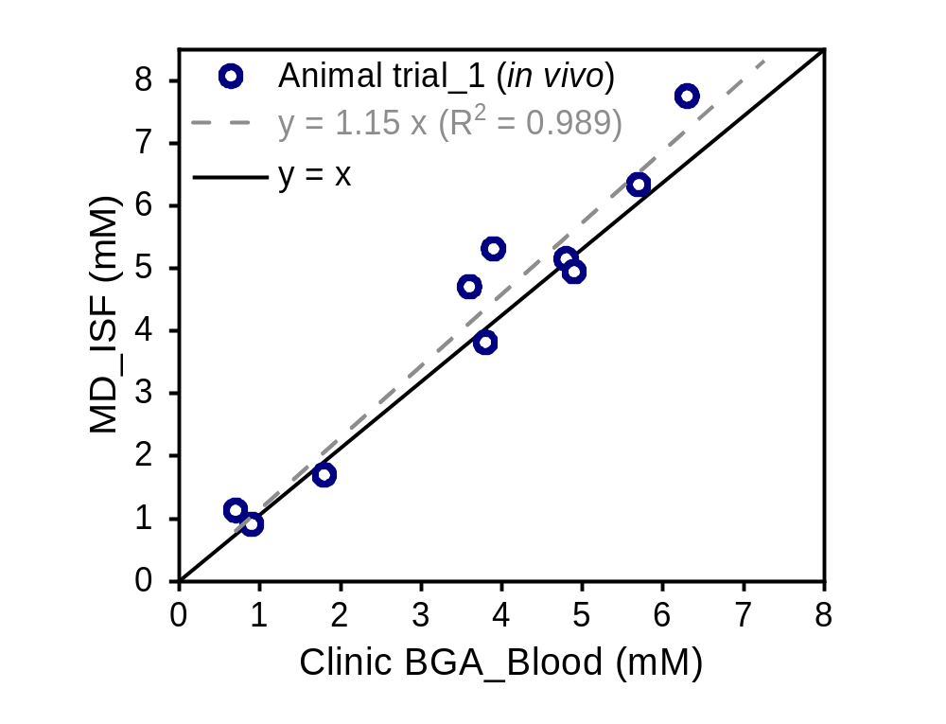
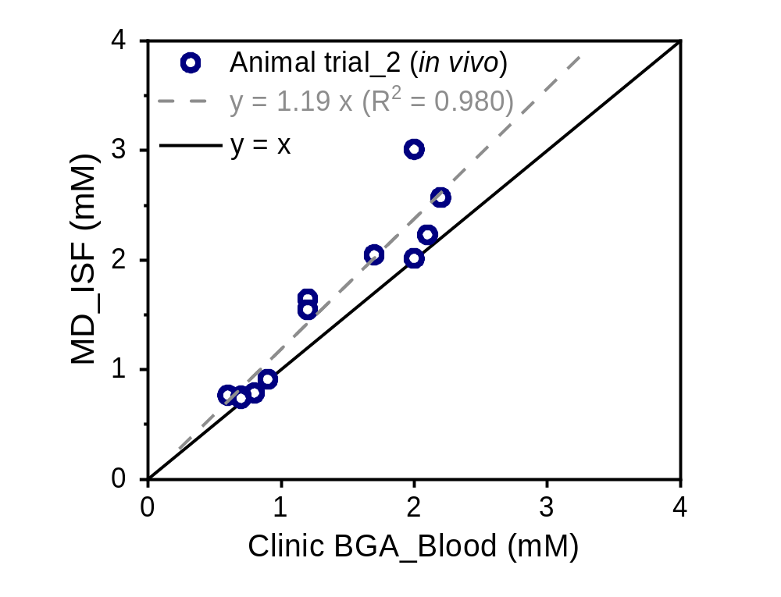
a)
b)
Notes:
Figure S9: Correlation between ISF lactate levels (droplet-based microfluidics, MD_ISF) and blood lactate levels (blood gas analyzer, Clinic BGA_Blood) across 2 in vivo animal trials (continuous mode): a) in vivo Animal trial_1 (n = 10) and b) in vivo Animal trial_2 (n = 11). ISF lactate concentrations were corrected for the microdialysis probe recovery (~1.1%) under continuous sampling mode.

Slide 15
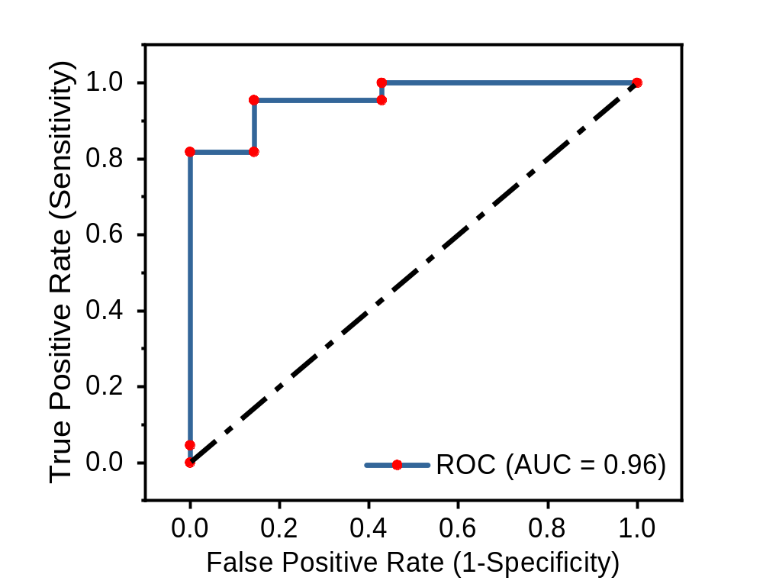
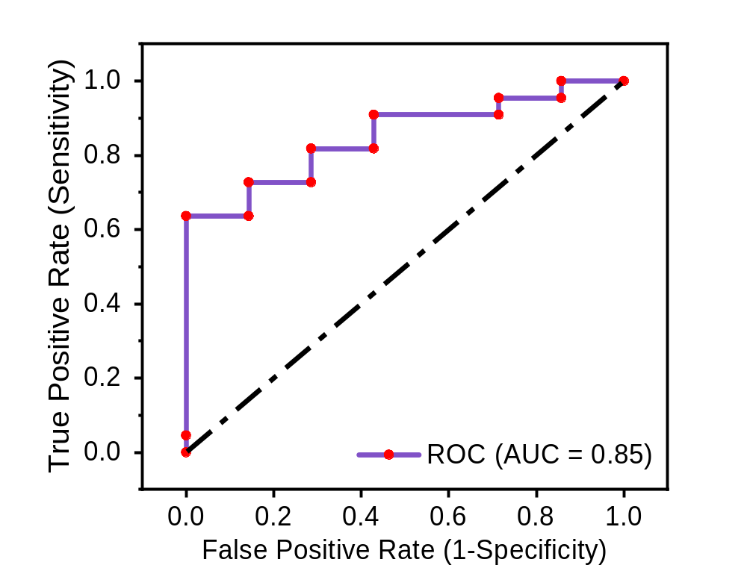
a)
b)
Notes:
Figure S10: Receiver operating characteristic (ROC) curve evaluating the diagnostic performance of the droplet-based microfluidics against clinical blood gas analyzer (reference method) with a clinical threshold of 2.0 mM. a) ROC curve comparing blood lactate measurements obtained from the droplet-based microfluidics (MD_Blood) and the blood gas analyzer (Clinic BGA_Blood), yielding an AUC of 0.96. b) ROC curve comparing blood lactate levels measured in the blood gas analyzer (Clinic BGA_Blood) and ISF lactate measured by droplet-based microfluidics (MD_ISF), yielding an AUC of 0.85.

